Slide 1
CIRCUIT AND SYSTEMS
COURSE CODE: ETEE-207
By
Mr. LALIT AGARWAL
ASSISTANT PROFESSOR
EEE, MAIT

Slide 2
LECTURE-2

Slide 3
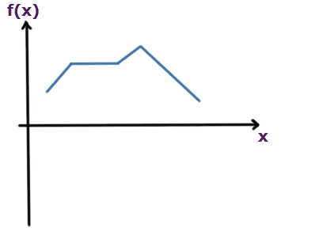
INTRODUCTION TO SIGNALS
A Signal is a function, that represents the variation of a physical quantity with respect to any parameter.
In the above figure, f(x) is the signal or function and x is the independent variable.

Slide 4
In electrical and electronics, usually signal is a variation of electrical quantity (generally I or V) with time i.e. the current and voltages are function of time.
So in general these function of time are called as signals i.e. signals are also called as functions.
If current or voltage remains same with change in time then it is not a signal but a dc value.

Slide 5
Signal is the key component behind virtually all:
Communication
Computing
Networking
Electronic devices
A signal can be either analog or digital.
Signals can be One-dimensional or multi- dimensional.
Example: voice signal, video signal, signals on telephone wires etc.

Slide 6
Note: Noise is also a signal, but the information conveyed by noise is unwanted hence it is considered as undesirable.
Signal: A function of one or more variables that convey information on the nature of a physical phenomenon.
Examples: v(t),i(t),x(t),heartbeat, blood pressure, temperature, vibration.
One-dimensional signals: function depends on a single variable, e.g., speech signal
Multi-dimensional signals: function depends on two or more variables, e.g., image

Slide 7
How is a Signal Represented?
Mathematically, signals are represented as a function of one or more independent variables.
For instance a black & white video signal intensity is dependent on x, y coordinates and time t f( x, y , t)
On this course, we shall be exclusively concerned with signals that are a function of a single variable: time
f(t)
t

Slide 8
Classification of signals
Continuous-time and discrete-time signals
Periodic and non-periodic signals
Casual and Non-casual signals
Deterministic and random signals
Even and odd signals

Slide 9
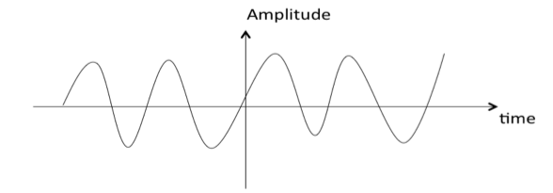
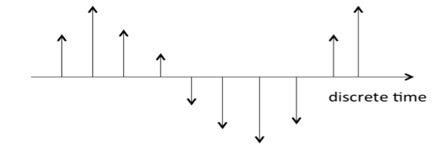
Continuous time& discrete time signals:
A signal is said to be continuous when it is defined for all instants of time.
A signal is said to be discrete when it is defined at only discrete instants of time.

Slide 10
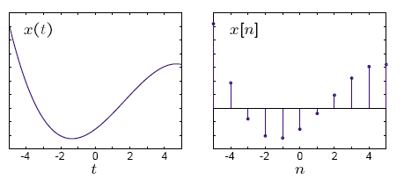

Slide 11
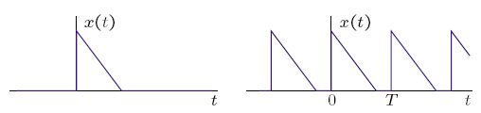
Periodic & Non-periodic Signals
Periodic signals have the property that x( t+T) = x( t ) for all t .
The smallest value of ‘T’ that satisfies the definition is called as the period.
Shown below are the non- periodic s ignal ( left) and a periodic s ignal ( r ight).

Slide 12
Examples:
sin(t), cos(t), etc are periodic signals.
e^{t}, t², t etc are non periodic signals.

Slide 13
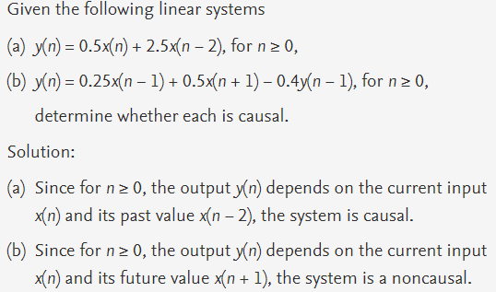
CAUSAL & NON-CAUSAL SIGNALS:
A system is said to be causal if its output depends upon present and past inputs, and does not depend upon future input.
For non causal system, the output depends upon future inputs also.

Slide 14
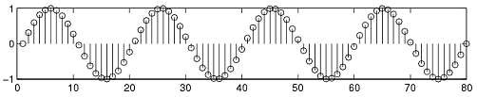
Deterministic & Random Signals
Deterministic signals :
Behavior of these signals is predictable w.r.t time.
There is no uncertainty with respect to its value at any time.
These signals can be expressed mathematically.
For example x(t) = sin(3t) is deterministic signal.

Slide 15

Random Signals
Behavior of these signals is random i.e. not predictable w.r.t. time.
There is an uncertainty with respect to its value at any time.
These signals can’t be expressed mathematically.
For example: Thermal Noise generated is non deterministic signal.

Slide 16
EVEN & ODD SIGNALS
A signal x(t) is referred to as an even signal if it is identical to its time-reversed counterpart.
i.e. x(-t) = x(t)
Examples: cos(t), sin²t, t^{n} where n is even etc. are even signals.
A signal x(t) is referred to as an odd signal if the signal is negative of it’s time-reversed counterpart.
i.e. x(-t) = - x(t)
Examples: sin(t), t^{n} where n is odd etc. are odd signals.

Slide 17
NOTE: There are some functions or signals which are neither even nor odd.
Examples: e^{t}, t²+t etc.
Any signal is a sum of unique even and odd signals.
i.e. x( t )= x _{e} ( t ) + x _{o} ( t )
Sum of even functions = Even functon
Sum of odd functions = Odd function

Slide 18
Multiplication of even and even functions = Even function
Multiplication of odd and odd functions = Even function
Multiplication of even and odd functions = Odd function
Sum of even and odd functions = Neither even nor odd

